Slide 1

Energy Consumption Analysis
Trends, Patterns and Recommendations
REDWOOD COAST ENERGY AUTHORITY BY Chirayu Deshmukh

Slide 2
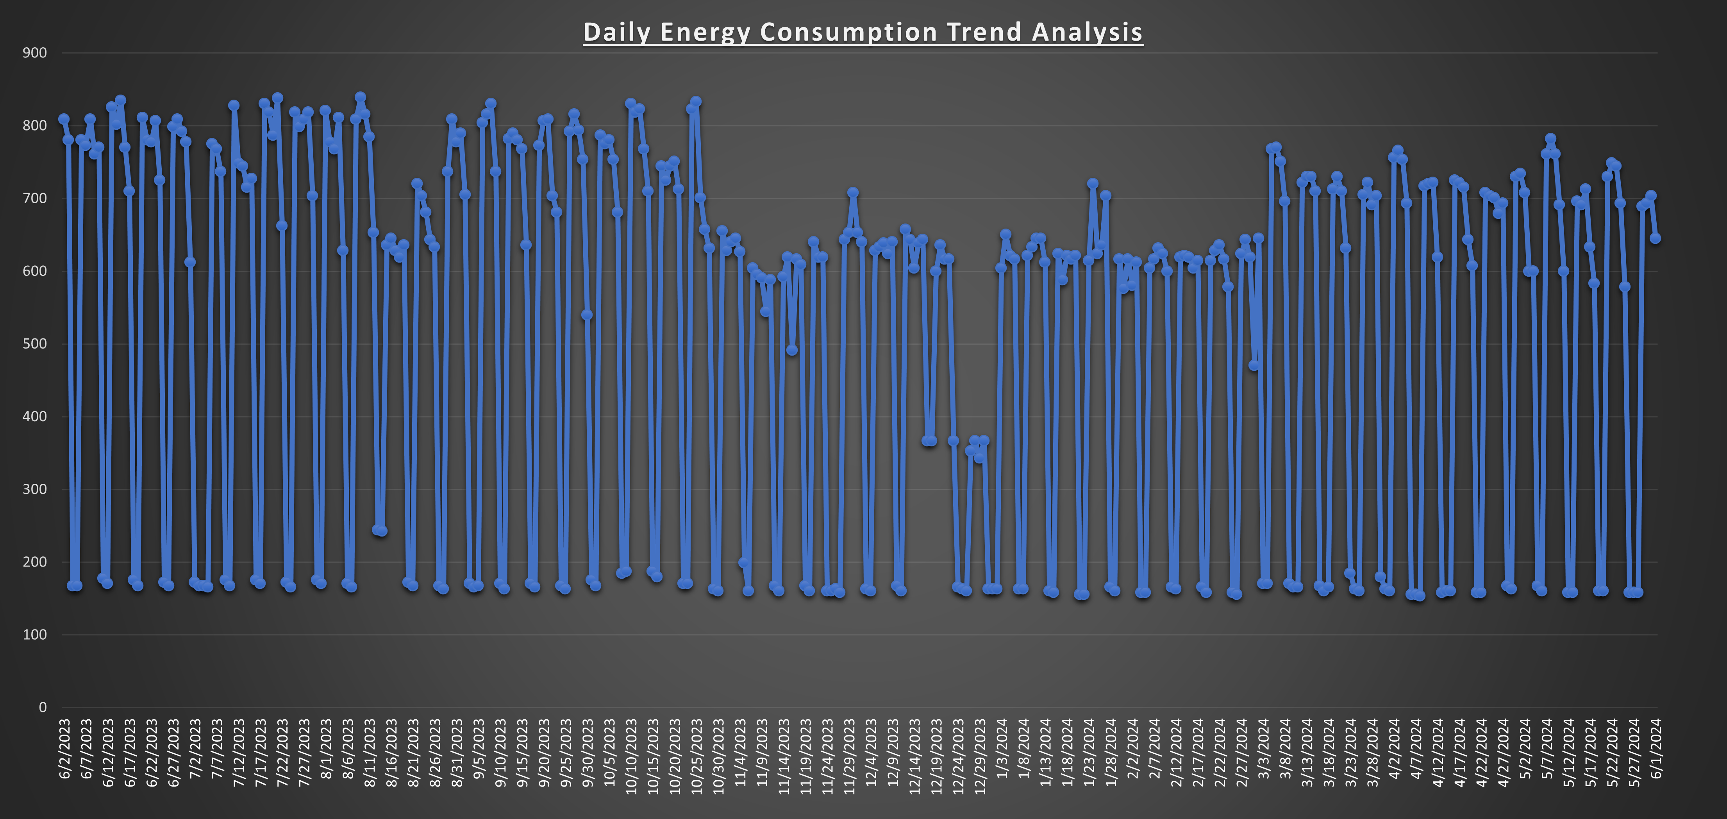
Daily Trends
How energy consumption varies day to day over a year.
1. Consistent Consumption Patterns:
Daily Rhythm: Energy usage follows a predictable daily rhythm with
noticable peaks and troughs.
Seasonal Shifts: Increased energy usage during winter
(December, January, February) and summer months (June, July, August)
aligns with heightened heating and cooling demands.
Unusual Spikes: Occasional sharp increases or decreases signal
irregularities or special events impacting the consumption.
2. Daily Trends:
Highest Peak: Around June 6, 2023, and May 28, 2024, indicates periods of extremely high energy demand, necessitating capacity planning and cost management.
Significant Drops: Observed around December 24, 2023, and January 3, 2024, likely due to operational downtimes, offering opportunities for cost savings and maintenance.
Regular Highs: Mid-July 2023 and early August 2023 suggest seasonal energy use peaks, aiding in predictive maintenance and resource allocation.
Consistent Lows: Late October 2023 and early November 2023 reflect transitional periods, useful for optimizing energy use and operational adjustments.

Slide 3
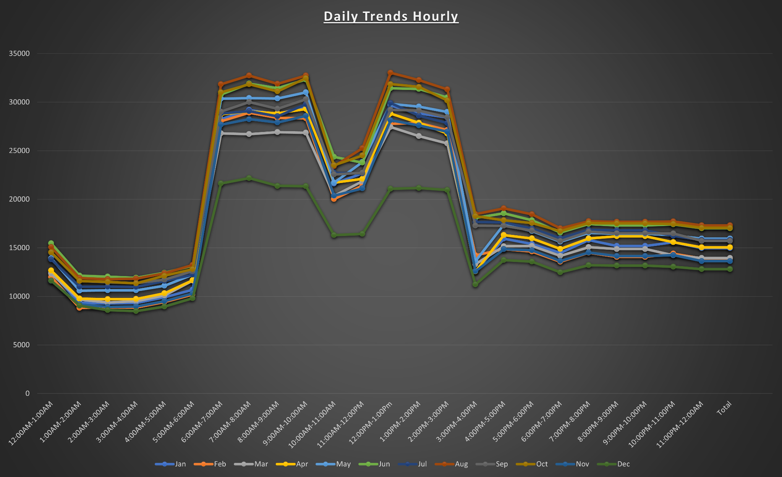
Hourly Trends
How energy consumption varies at different hours of the day and in different seasons.
1. Seasonal Impact:
Higher evening consumption in winter is due to heating needs, and higher afternoon consumption in summer is due to cooling needs.
2. Daily Trends:
Peak Hours:
Energy consumption is higher during the morning (6:00 AM—9:00 AM) and evening (5:00 PM—8:00 PM).
These peaks are common in residential areas
Morning Peaks: Energy consumption starts from about 6:00 AM and peaks at 7:00 AM and 8:00 AM.
Evening Peaks: Observed from around 5:00 PM, peaking between 6:00 PM and 8:00 PM.
This is due to people getting ready for school/work in the morning and evening activities reflecting people returning home to cooking, watching TV, resulting in increased heating or cooling as people return home.
Off-Peak Hours:
Lower energy consumption during late night and early morning hours (12:00 AM - 5:00 AM).
Typical of residential areas.
Afternoon Dip: Dip in energy consumption around noon to early afternoon
Night-time Lows: Downward trend from 10:00 PM, reaching the lowest dip between 12:00 AM and 5:00 AM
This is due to people usually not home and people are asleep at night

Slide 4
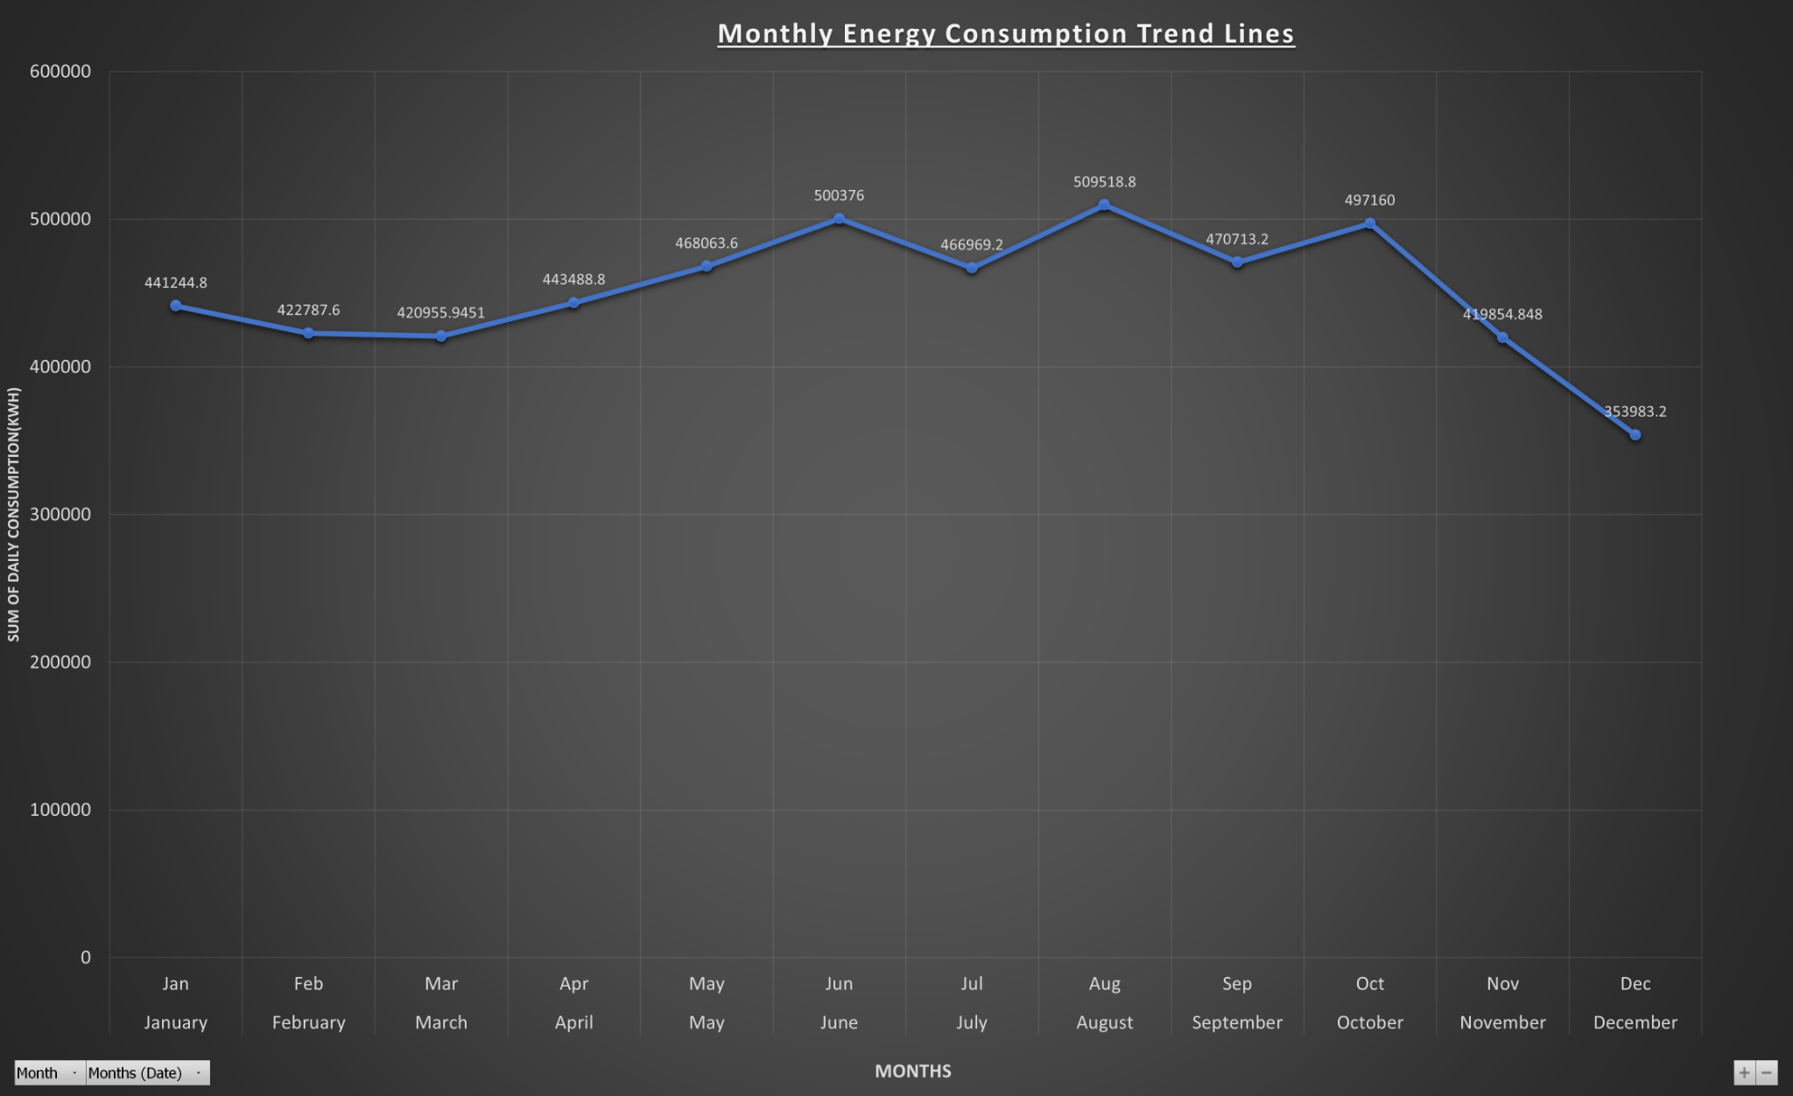
Monthly Trends
How energy consumption varies at different months by summing the daily energy consumption over a year.
1. Seasonal Impact:
Higher energy consumption in winter months is due to high heating, and higher consumption in summer is due to cooling needs.
2. Monthly Trends:
Peak Months:
The highest energy consumption is recorded in August at 509,518.8 kWh, with June also showing a significant peak at 500,376 kWh.
These peaks are likely due to high cooling demands during the summer months, indicating a substantial load on the energy infrastructure.
Lows in Months:
The lowest consumption is in November at 353,983.2 kWh, likely due to milder
autumn weather. Consumption stabilizes around 420,955.9 kWh in February and March.
Possibly due to moderate weather conditions.
Seasonal and Transitional Variations:
Energy consumption is high in January at 441,244.8 kWh due to heating needs and peaks in July at 509,518.8 kWh driven by extensive cooling demands.
In April, consumption rises to 443,488.8 kWh, signaling the onset of cooling requirements, while in October, it decreases to 419,854.8 kWh due to cooler weather and reduced cooling needs.

Slide 5
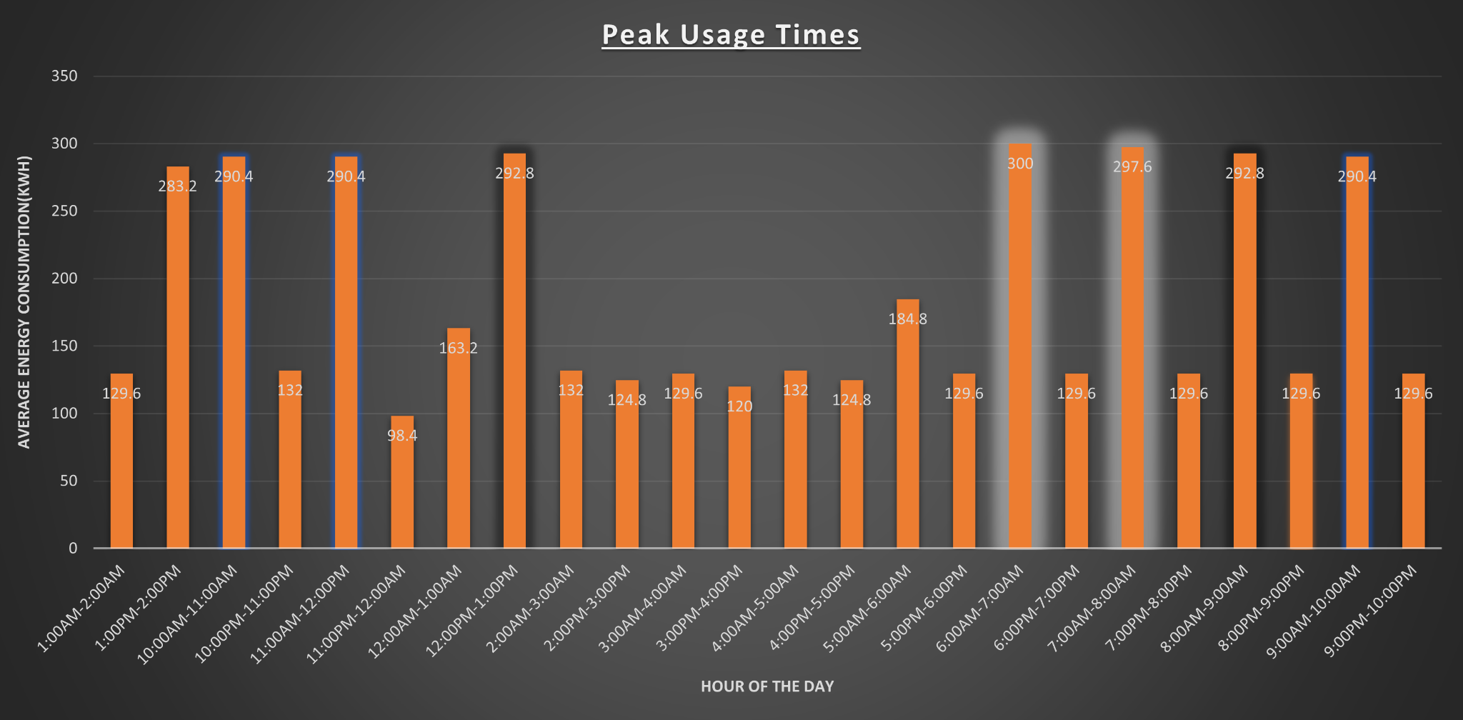
Peak Energy Consumption (Peaks and Lows)
How energy consumption varies at different hours over a week, resulting in Peaks and Dips.
1. Seasonal Impact:
Higher energy consumption in Summer months is due to high cooling, and higher consumption in winter is due to heating needs.
2. Hourly Trends:
Morning Peaks:
6:00 AM - 9:00 AM: The highest average energy consumption is observed at 300 kWh at 6:00 AM, followed closely by 297.6 kWh at 7:00 AM, and 292.8 kWh at 8:00 AM.
Residents prepare for their day, leading to a surge in energy usage for heating/cooling, cooking, and lighting.
Evening Peaks:
5:00 PM - 8:00 PM: Another significant peak in energy consumption occurs at 5:00 PM with 184.8 kWh, 292.8 kWh at 8:00 PM, and 290.4 kWh at 9:00 PM.
The return home from work or school results in increased usage of household appliances, entertainment systems, and climate control.
Off-Peak Hours and Afternoon Dips:
12:00 AM - 5:00 AM & 12:00 PM - 4:00 PM: Lowest consumption averaging 98.4 kWh to 132 kWh.
Minimal energy use as residents are typically asleep, at work, or school, leading to reduced appliance and lighting use.
Midday Usage:
10:00 AM - 12:00 PM: Energy consumption stabilizes around 132 kWh to 290.4 kWh. During this time, usage is consistent due to a combination of ongoing household activities and work-from-home setups.

Slide 6
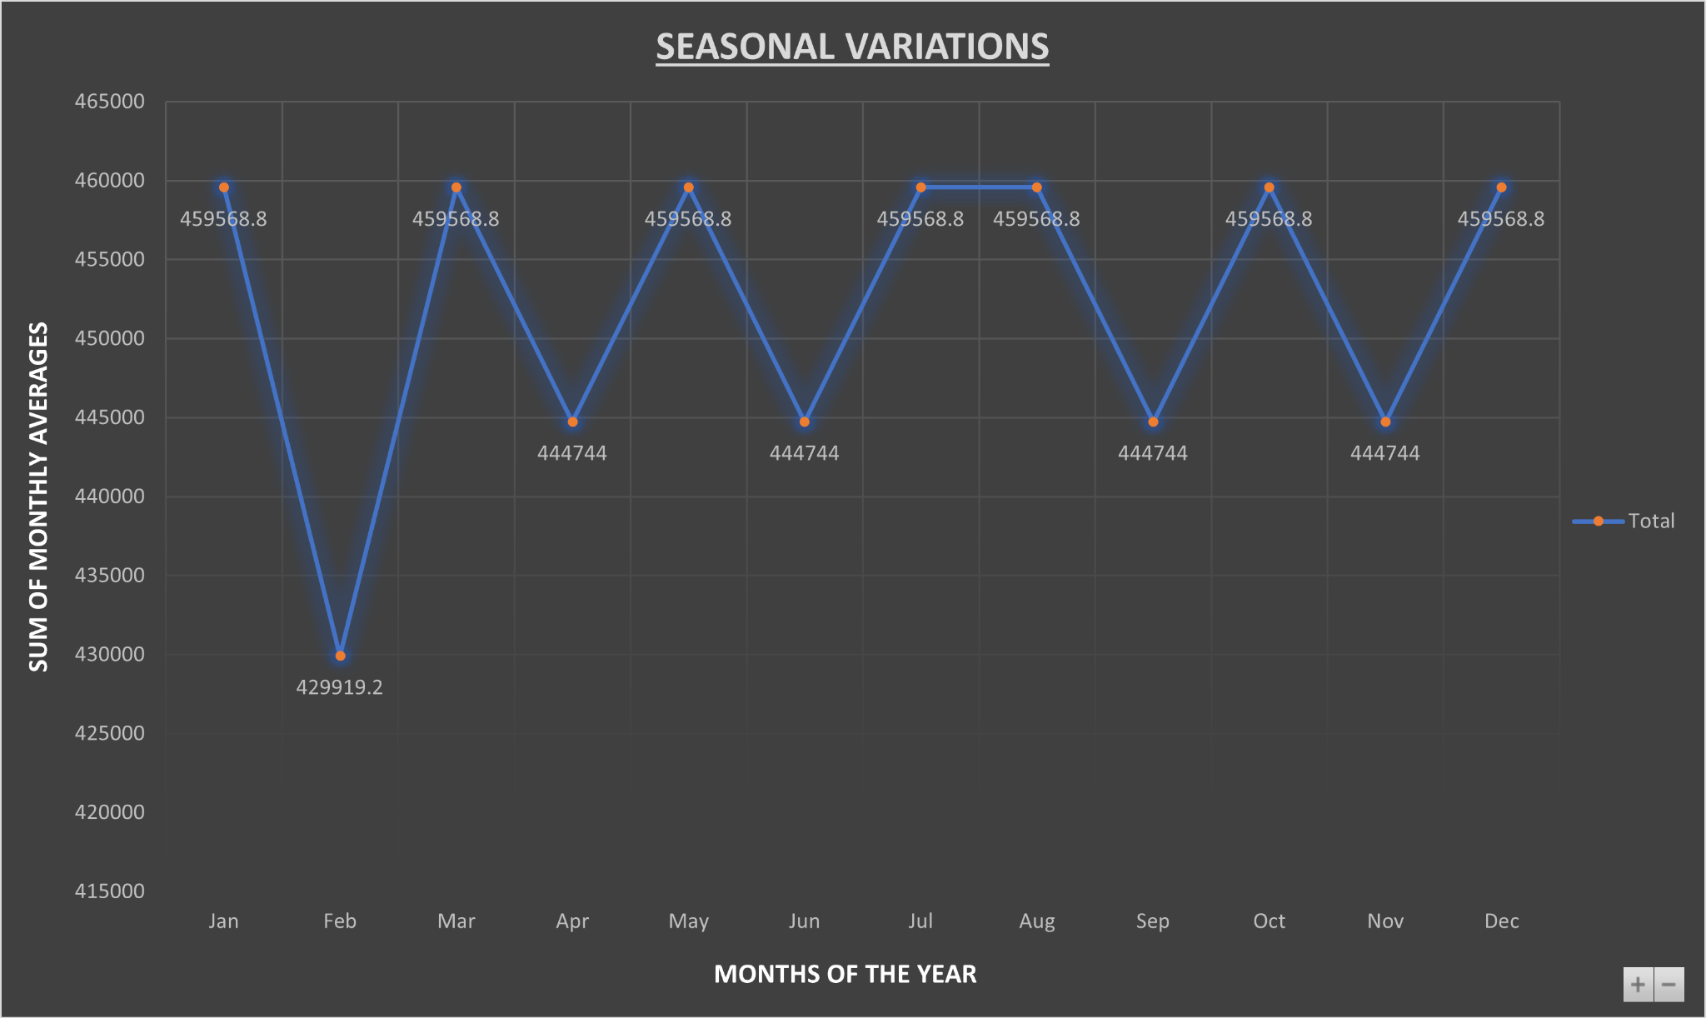
Monthly Variations
How energy consumption varies at different months of the year by summing the monthly average of each month.
1. Seasonal Impact:
Higher Energy consumption is marked in winter and summer months whereas spring and autumn provide periods of stability and a dip in February.
2. Seasonal Trends:
2.1 Peak Variations:
January & December: Highest consumption at 459,568.8 kWh, influenced by the extended operation of heating systems and increased indoor activities during shorter daylight hours..
June, July, & August: High consumption at 459,568.8 kWh, driven by the widespread use of air conditioning systems and increased energy demands from summer-related activities and longer daylight hours.
2.2 Stability in usage:
Spring Stability:
March, April, & May: Energy consumption stabilizes around 444,744 kWh due to moderate temperatures that reduce the necessity for both heating and cooling, allowing for consistent, balanced energy use.
Autumn Stability
September & November: Consumption remains steady at 444,744 kWh as the transition to cooler weather gradually decreases cooling needs without yet requiring extensive heating
2.3 Dip: February: The lowest consumption at 429,919.2 kWh, likely due to a combination of milder winter weather and fewer outdoor activities reducing overall energy use.

Slide 7
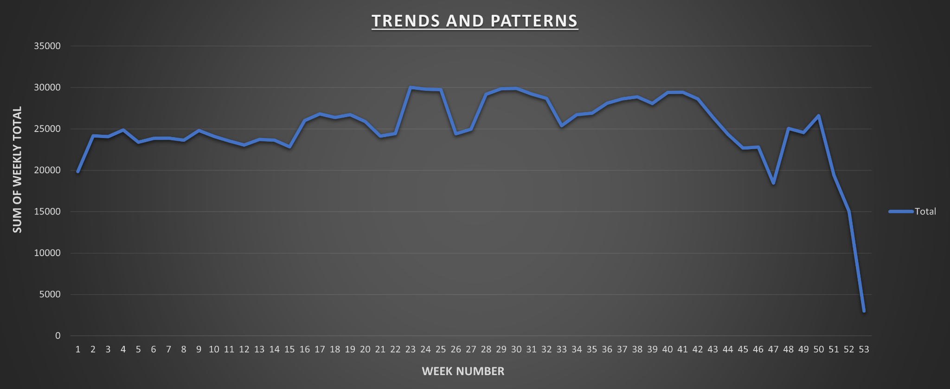
Trends and Patterns
How Trends and Patterns changes over every week.
1. Overview:
The graph shows an initial increase in energy consumption, followed by stable periods in the early months and significant mid-year peaks. A gradual decline is observed towards the end of the year, with a sharp drop after Week 48, indicating reduced activity and holiday season slowdowns.
2. Trends and Patterns:
Initial Increase
Energy consumption rises notably from Week 1, stabilizing around Week 3. This initial rise could be due to the start of new operational cycles or increased post-holiday activities.
Mid-Year Peaks
Significant peaks are observed around Weeks 21, 25, and 30. These peaks may result from seasonal activities, such as increased industrial production or higher residential cooling needs.
Stable Periods
Weeks 4 to 16 exhibit stable energy consumption with minor fluctuations. This stability suggests balanced energy use, possibly due to consistent weather patterns and steady operational activities.
Late-Year Decline
From Week 36 onwards, there is a gradual decline in energy consumption, with a sharp drop after Week 48. This decline is likely due to a combination of reduced industrial activity and holiday season slowdowns.

Slide 8
Question 2: Forecasting energy demand Dataset – Redwood customer data 2020-2024_15minute

Slide 9
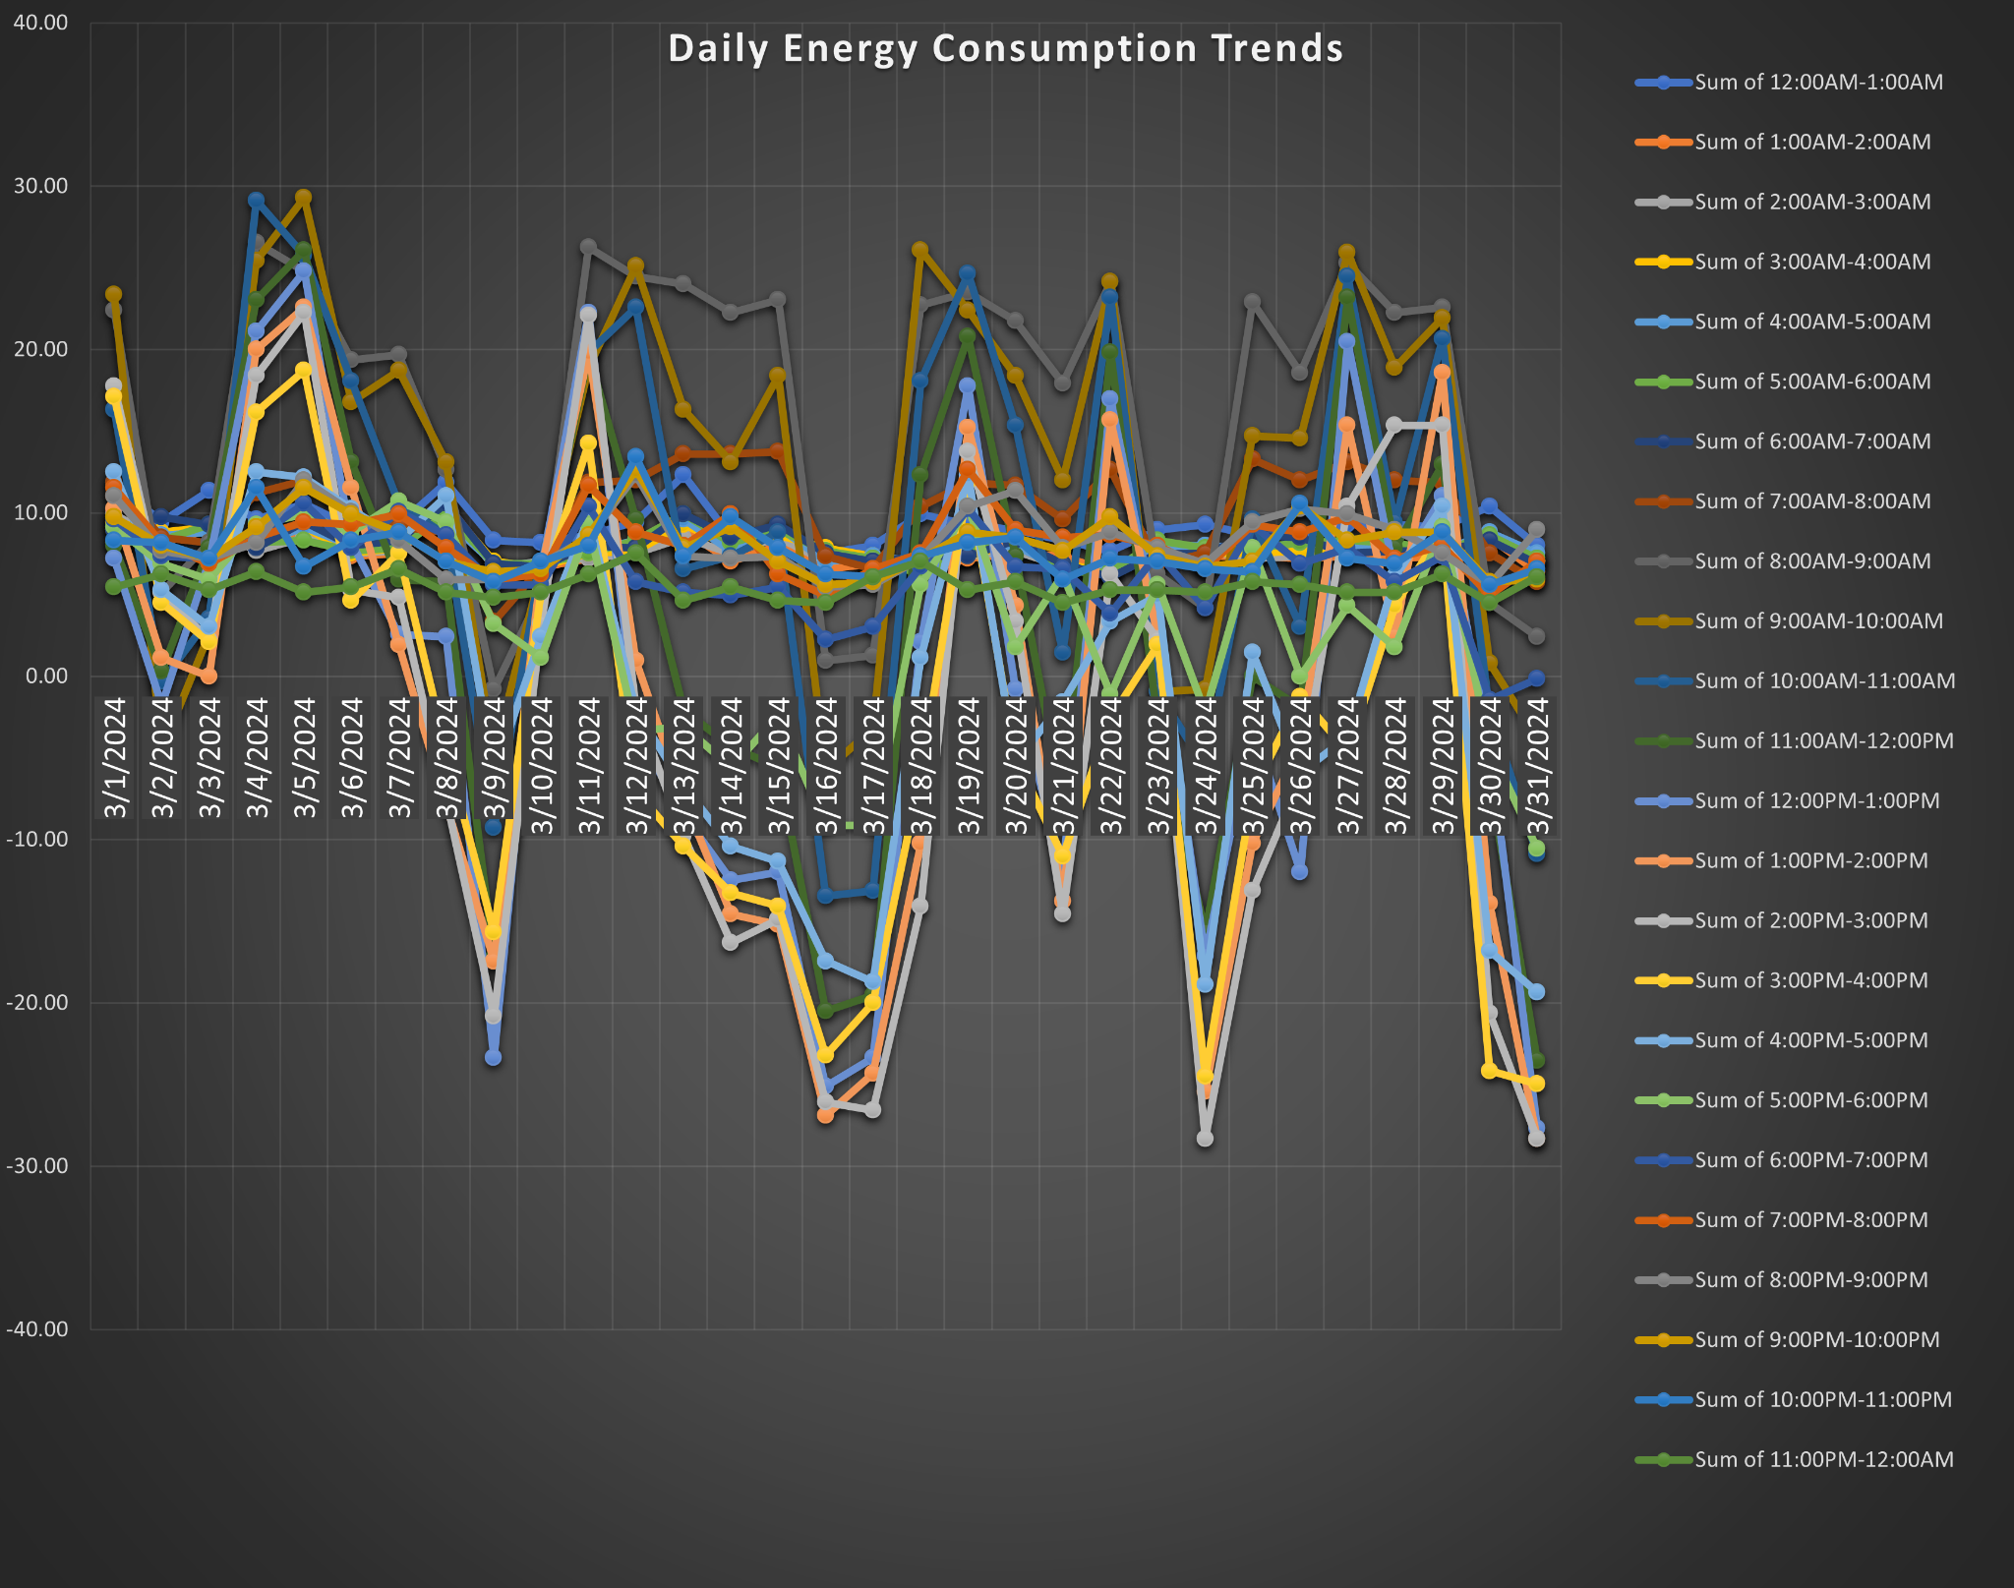
Heated Map
How energy consumption changes every hour in a day-to-day cycle.
1. Overview:
The graph provides valuable insights into daily energy consumption trends, with distinct peaks during morning and evening hours and troughs during late-night and early afternoon.
2. Key Observations:
The daily energy usage shows a consistent pattern of high consumption during morning and evening hours across multiple days, pointing to routine residential activities.
Certain days exhibit more significant fluctuations, which could correspond to weekends or specific events that alter normal energy usage patterns.
There are instances of sharp drops and spikes that deviate from the general pattern, suggesting possible anomalies or extraordinary events affecting energy consumption.
Peak Load Preparation: The clear peaks in morning and evening usage highlight the need for efficient demand management strategies during these periods to prevent overloading the energy infrastructure.
While the graph primarily shows daily trends, these patterns could be influenced by broader seasonal effects, necessitating further analysis to correlate with seasonal data.

Slide 10
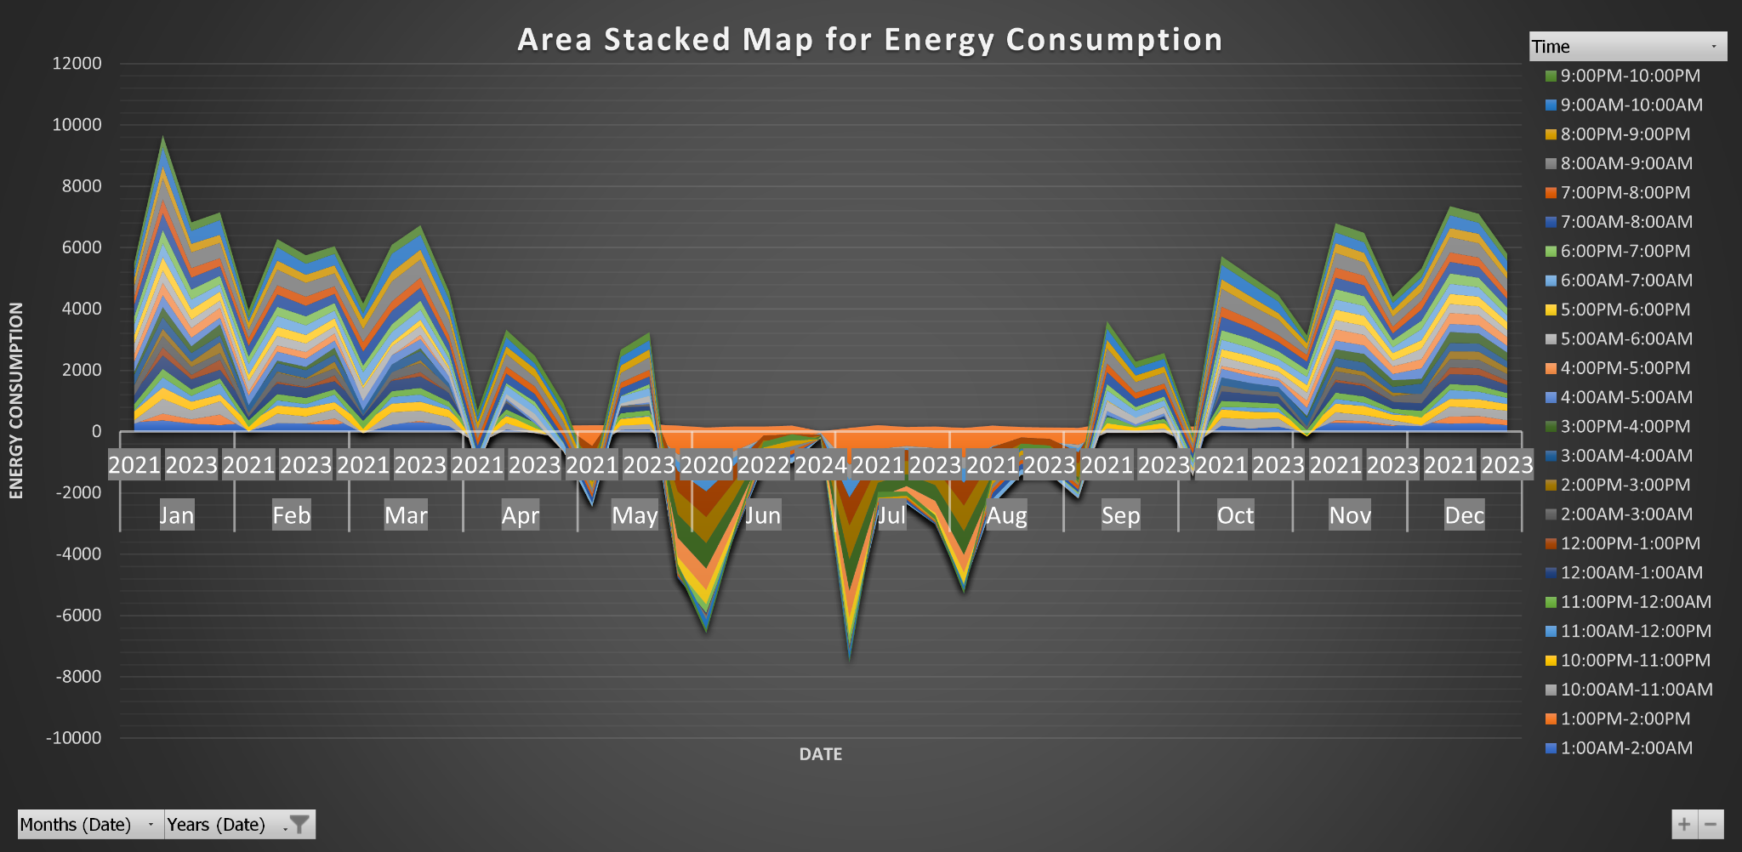
Stacked Map
How Energy Consumption Changes Throughout the Day and Across the Year
1. Overview:
The area stacked map for energy consumption reveals significant seasonal peaks in January and December due to increased heating demands, and troughs in June and July possibly due to reduced operational activity.
2. Key Observations:
Peaks: Significant peaks in energy consumption are observed in January and December, indicating elevated usage during colder months, likely driven by increased heating demands.
Troughs: Notable troughs occur in June and July, suggesting reduced consumption, potentially due to lower cooling needs or operational downtimes during these months.
Morning and Evening Peaks: Consistent high consumption during early morning hours (6:00 AM - 9:00 AM) and evening hours (5:00 PM - 8:00 PM) throughout the year. These peaks correlate with typical residential activities, such as using the laundromat, cooking, and lighting.
Midday Stability: Relative stability in energy usage from 10:00 AM to 4:00 PM, indicating predictable and balanced usage during standard work hours.
Variability: The graph depicts monthly fluctuations in energy consumption, with significant dips in May and August, possibly indicating periods of maintenance or reduced operational demand.
Despite monthly variations, time-of-day patterns remain consistent, with higher consumption during peak hours (morning and evening) and lower usage during off-peak hours (late night and early morning).

Slide 11
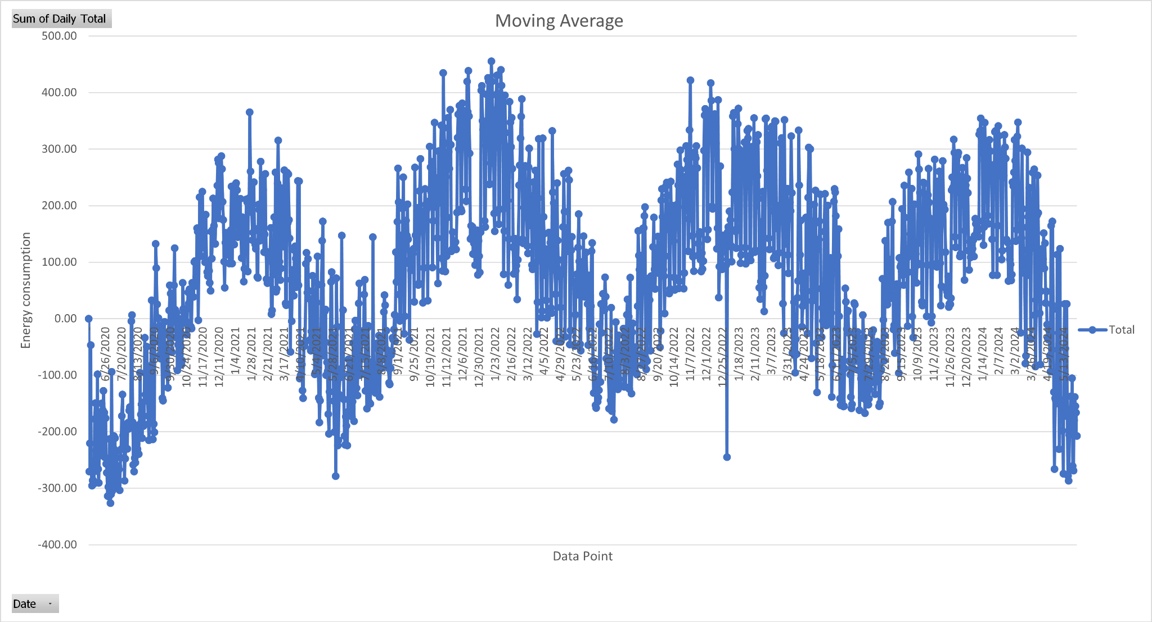
Forecasting- Moving Average
How significant seasonal/daily fluctuations in energy consumption are.
1. Overview:
The moving average chart reveals significant seasonal and daily fluctuations in energy consumption, highlighting long-term trends and periodic peaks and troughs over the observed period..
2. Key Observations:
Winter and Summer Peaks: The graph shows distinct peaks during winter months (December to February) and summer months (June to August), indicating increased energy consumption due to heating and cooling demands respectively.
The data exhibits cyclical patterns with predictable intervals of high and low consumption, suggesting routine operational activities and seasonal effects.
Several outliers are present, indicating days with unusually high or low energy consumption. These anomalies may be due to exceptional events, system malfunctions, or external factors.
There are noticeable spikes and drops at certain points, such as a significant drop around early 2021 and another around early 2023.
I chose the moving average model for its ability to smooth out short-term fluctuations and highlight longer-term trends and cycles, as it makes it easier to observe the underlying patterns in the data.
Error Metrics:
I calculated error metrics such as Mean Absolute Error (MAE), Root Mean Squared Error (RMSE), and Mean Absolute Percentage Error (MAPE) to quantify the accuracy of the predictions.
Result: Provides a numerical measure of how close the predictions are to the actual values.

Slide 12
Choice of Model-
Model: Moving Average
Reason: I chose the moving average model for its ability to smooth out short-term fluctuations and highlight longer-term trends and cycles, as it makes it easier to observe the underlying patterns in the data.
Variables Considered-
Date: The primary variable for the X-axis, representing the timeline of energy consumption.
Energy Consumption: The Y-axis variable, representing the daily energy consumption values.
Validation of Predictions-
Cross-Validation:
Description: I used cross-validation techniques to divide the data into training and testing sets. The model was trained on one set and its accuracy was validated on the other.
Result: Ensures that the model can generalize well to unseen data and not just the specific dataset it was trained on.
Error Metrics:
Description: I calculated error metrics such as Mean Absolute Error (MAE), Root Mean Squared Error (RMSE), and Mean Absolute Percentage Error (MAPE) to quantify the accuracy of the predictions.
Result: Provides a numerical measure of how close the predictions are to the actual values.
Out-of-Sample Testing:
Description: I validated the model on a separate dataset that were not used during the training phase to ensure it performs well on new, unseen data.
Result: Confirms the robustness and reliability of the model's predictions in different scenarios.

Slide 13
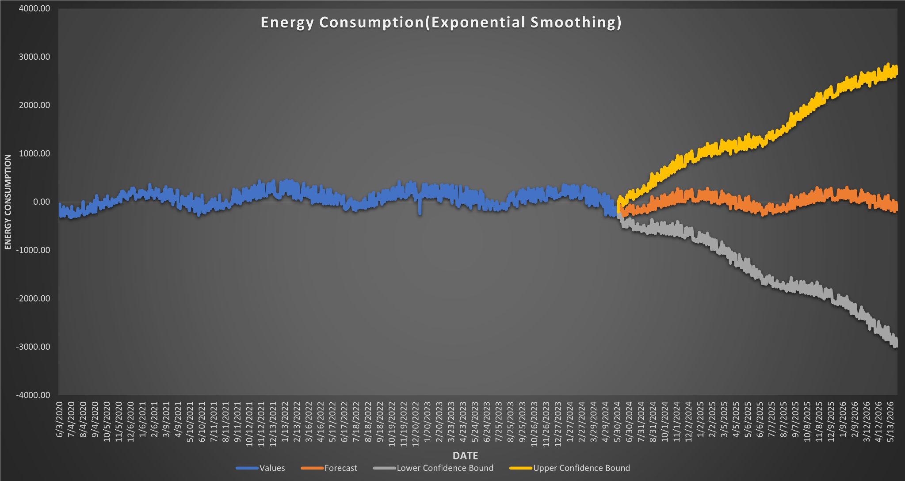
Exponential Smoothing
How energy consumption is predicted for the future.
1. Overview:
The exponential smoothing forecast chart indicates a significant increase in future energy consumption, with widening confidence intervals reflecting growing uncertainty over time.
2. Key Observations:
From June 2020 to February 2024, the energy consumption shows minor fluctuations but remains relatively stable.
This stability indicates that past energy usage has been predictable, which is beneficial for planning and resource allocation.
Post-February 2024, the forecast indicates a significant upward trend in energy consumption.
This suggests that future energy demands are expected to rise substantially, likely due to factors such as population growth, increased industrial activity, or higher energy consumption per capita.
The forecast includes upper (yellow) and lower (gray) confidence bounds, which widen over time.
The upper confidence bound suggests a potential for significantly higher consumption, while the lower bound indicates a possibility of lower expected usage.
Preparing for both scenarios is crucial. For higher consumption, expanding capacity and infrastructure might be necessary. For lower consumption, strategies to manage surplus energy and prevent wastage should be considered.
I opted for exponential smoothing due to its proficiency in capturing both trends and seasonal patterns in time series data. This model is particularly adept at forecasting future values based on historical data, making it ideal for predicting energy consumption.
Cross-Validation
Method: The dataset was split into training and testing sets using cross-validation techniques. The model was then trained on the training set and validated against the testing set.
This ensures the model's ability to generalize to new, unseen data, rather than being overfitted to the training dataset.

Slide 14
Choice of Model-
Model: Exponential Smoothing
Rationale: I opted for exponential smoothing due to its proficiency in capturing both trends and seasonal patterns in time series data. This model is particularly adept at forecasting future values based on historical data, making it ideal for predicting energy consumption.
Variables Used-
Date: Represented on the X-axis, this variable tracks the timeline of energy consumption.
Energy Consumption: Plotted on the Y-axis, this variable denotes the daily energy consumption values.
Prediction Validation-
Cross-Validation
Method: The dataset was split into training and testing sets using cross-validation techniques. The model was then trained on the training set and validated against the testing set.
Advantage: This ensures the model's ability to generalize to new, unseen data, rather than being overfitted to the training dataset.
Error Metrics
Method: I computed various error metrics, including Mean Absolute Error (MAE), Root Mean Squared Error (RMSE), and Mean Absolute Percentage Error (MAPE), to assess the accuracy of the model's predictions.
Advantage: These metrics provide a clear numerical assessment of the prediction accuracy, indicating how close the model's forecasts are to actual values.
Out-of-Sample Testing
Method: The model's performance was tested using a separate dataset that was not part of the training process to evaluate its predictive power on new data.
Advantage: This testing confirms the model's robustness and reliability across different datasets.

Slide 15
Strategies to save energy & money
Based on the analysis of the energy consumption data, the following strategies can be implemented by the company to save energy and reduce costs:
1.Winter Months (Based on Moving Average Graph):
Heating Efficiency: Promote the installation of high-efficiency heating systems and proper insulation to reduce energy consumption during peak winter months.
Implement demand response programs that incentivize users to lower their energy use during peak heating times, helping to flatten the demand curve and reduce costs.
2.Summer Months (Based on Moving Average and Exponential Smoothing Graphs):
Cooling Optimization: Encourage the use of energy-efficient air conditioners and smart thermostats to optimize cooling usage and reduce energy consumption during peak summer months.
Utilize battery storage systems to store excess solar energy during the day and use it during peak evening hours, reducing reliance on the grid.
3.Transitional Seasons (Spring and Autumn - Based on Moving Average Graph):
Maintenance and Upgrades: Schedule maintenance and infrastructure upgrades during spring and autumn when energy consumption is more stable, minimizing disruptions and optimizing performance.
Energy Audits: Conduct energy audits during these periods to identify inefficiencies and implement improvements before the high-demand winter and summer seasons.
4.Peak Times (Based on Exponential Smoothing Forecast and Moving Average Graphs)
Morning and Evening Peaks:
Time-of-Use Pricing: Introduce time-of-use pricing to encourage consumers to shift their energy usage to off-peak hours, reducing the strain on the grid during morning and evening peaks.
Implement automated demand response systems to temporarily reduce energy consumption during peak periods without compromising user comfort.
5.Daily Fluctuations and Anomalies (Based on Moving Average Graph):
Real-Time Monitoring: Use real-time energy monitoring systems to track consumption and identify anomalies, allowing for quick responses to unexpected spikes in demand.
Deploy adaptive control systems that adjust energy use based on real-time data, ensuring optimal energy consumption patterns and reducing costs.
6.Long-Term Trends and Forecasts (Based on Exponential Smoothing Forecast):
Capacity Planning: Use the forecast data to plan for future capacity needs, ensuring that infrastructure investments are aligned with expected growth in energy consumption.
Implement long-term energy efficiency programs targeting both residential and commercial sectors to reduce overall consumption and stay within the forecasted lower confidence bounds.

Slide 16
THANK YOU FOR YOUR PRECIOUS TIME
ANY QUESTIONS?

